Slide 1
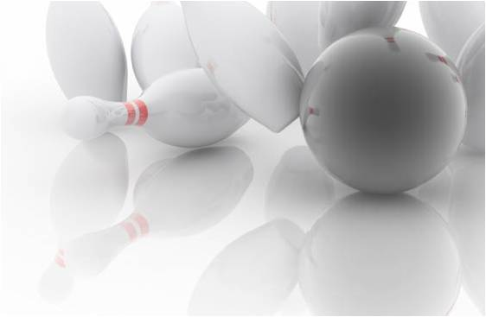


Yuma USBC
League Officers Workshop
16 August 2026

Slide 2

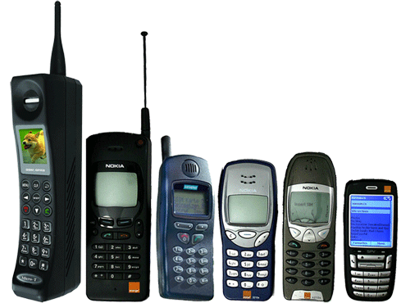
Silence Your Cell Phones

Slide 3
Association Officers
President
Vice President
John Schofield
Vikki Erickson
Telephone: (928) 580-4105
Telephone: (928) 580-1562
Email:
vikki.erickson@yahoo.com
Email: littlejohnz@yahoo.com

Slide 4

Association Manager
Lance Stern
Telephone: (928) 503-4348
Yuma USBC
3100 W 16th St 9B
Yuma, AZ 85364
Email: lanceastern@gmail.com
Your Leagues POC with the Association

Slide 5
Association Directors
3 Year
2 Year
1 Year
Paul Bell
Ted Turner
Amy Kennedy
Monica Salazar
Robert Sapp
Robin Wilson
Vacant Position
Mandy Mistriel
Carla Williams
Alan Lewis
Vacant Position
Lance Stern
Red indicates Youth Directors
2 Director positions available
Anyone want an Application for Director?

Slide 6

Association Website
www.yumausbc.org
Calendar of Events
  Community Issues
  Scholarships & Awards
  Tournaments & Entries
Download Forms
  Secretary Toolbox
  Presidents Toolbox
Can’t find what you need, ASK!

Slide 7

Communication
Facebook.com/YumaUSBC
@YumaUSBC
Like Us & Follow Us to get important information
Social Media – We will post as much info about events and special happenings going on in the Yuma USBC Area and Events that are relevant to the Yuma Bowlers. Let us know if you have anything that you would like to see or posted.

Slide 8

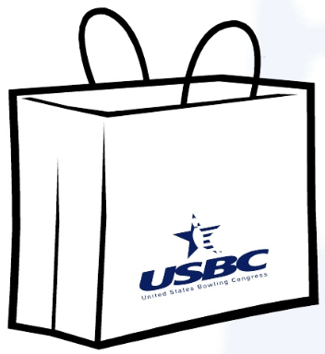
Your Kit Includes:
League Officers Welcome Letter
USBC League Sanction Application
USBC Membership Applications
High Score Awards Forms
Local Association Calendar of Events
2025-2026 Average Bluebook – Coming Soon
BVL Information Material
Lane Talk Flyer
Join USBC On-line Flyer
Sample Adult Rules – Fill-in the blank
- Rules to Consider FAQ
League Folder
- Alphabetical List of Bowlers
- Team Sign-up Sheets from last year
- Blank Sign-up Sheets
Fun Tournament Entries – on the website

Slide 9

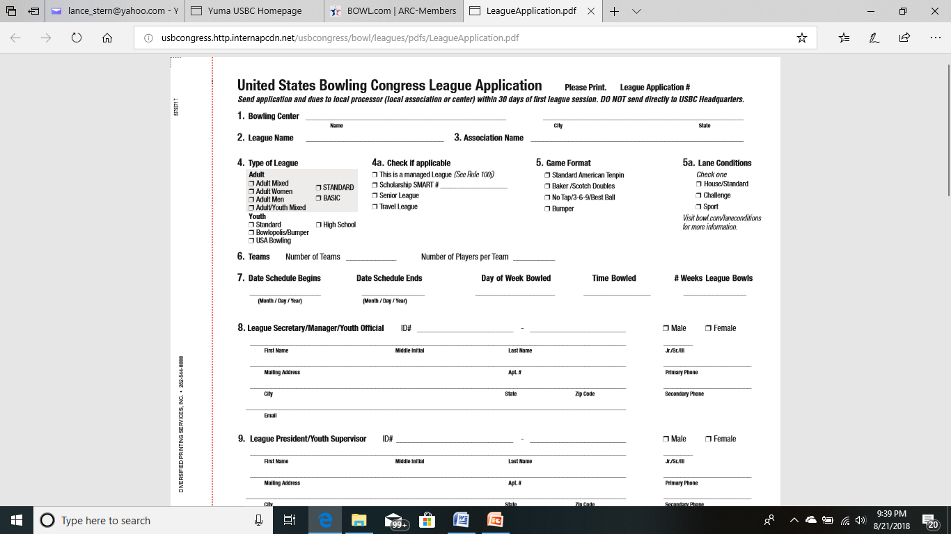
USBC League Application
132975
Mark what your sanctioning
X
If Changes, Report it to Assoc Manager
Not all lane dressing is a “house” shot. There are specific variances that determine whether the lane condition is a House/Standard, Challenge or Sport shot. Averages bowled on Challenge or Sport conditions must be converted using the respective conversion chart. Additionally, we want you to know if the pattern changes throughout the season, the condition is not House/Standard, it must be marked Challenge.
Use Dark Ink
Print Clearly
ORIGINAL submitted to Assoc. Manager
Keep a copy for your records

Slide 10
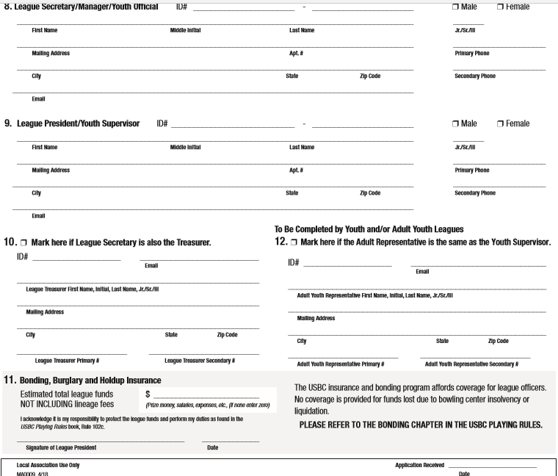
USBC League Application Continued
All Info Needed
Youth Leagues
  Youth Reps
USBC Bonding
  League Funds
  Except Lineage
President Signs
Submit within 30 days of League Start

Slide 11
2026 – 2027 Dues Structure
Adults
Adults
$29.00
$10.00
National $15, Local $10, State $4
National $7.00, Local $3
Standard Membership
Basic Membership
16 week session or shorter
Youth – $4 National Dues
Junior Gold Upgrades Available

Slide 12

USBC Membership Cards
Standard Membership
Basic Membership
Same Member # No Duplicates
  Member sent an ID card to mailing address submitted
Bowl.com
  Reprint feature
  “Find a Member”
Bowl.com App
  Show Card
  “Find a Member”
  Bowler stats
  Averages
  Honor Scores
Same Member # No Duplicates
  No card sent to bowler
  Print from bowl.com
Bowl.com
  Print feature
  “Find a Member”
Printing Membership Card
  Will only print in color with a color printer.

Slide 13
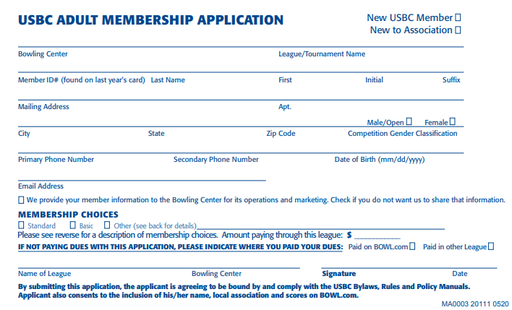
Adult Membership Cards
PRINT Information Clearly & Legible
X

Slide 14
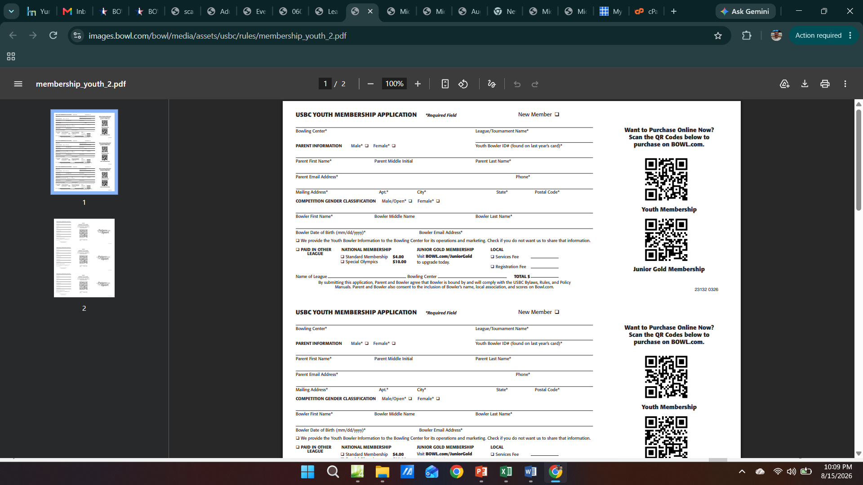
Youth Membership Cards
PRINT Information Clearly & Legible
Web interface
Parent Info
Youth Info
Retain the same USBC bowler ID#
e-mail address required

Slide 15


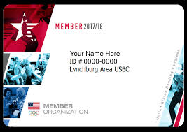
Yuma USBC Youth Registration
$10 Registration Fee:
Breakdown:
$4 USBC Membership
$6 for association use
- $3 Processing fee
- $3 Awards Program
Registered Volunteer Program (RVP)
USBC created the Registered Volunteer Program (RVP) to assure parents that we provide as safe an environment as possible for USBC Youth bowlers.
USBC Youth Membership:
Upgrade Options:
Jr Gold U12 $25.00
Jr Gold U14 $40.00
Jr Gold U16 $50.00
Jr Gold U18 $50.00

Slide 16

USBC Member Rewards
Membership Value
Thousands of USBC members are benefiting from great discounts through our Member Rewards program!
As a USBC member, you unlock exclusive rewards! Enjoy discounts on gear, apparel, travel, automotive, every day needs and much more! Check out the array of discounts available to you as a USBC member.
Check Bowl.com for specifics on each Members Reward

Slide 17
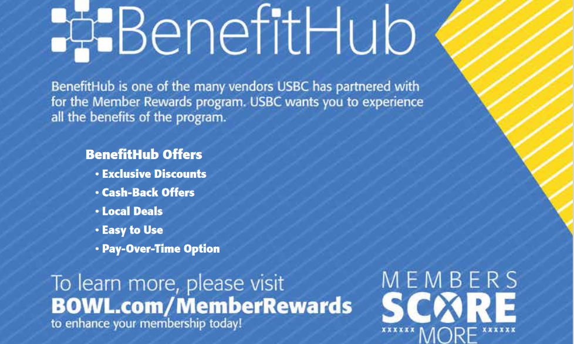
USBC Member Rewards

Slide 18
USBC Adult Basic Memberships
2014 – 2015 First Introduced
  16 or fewer sessions, Cost is $10
Memberships good for that league only
  purchase/upgrade for another short-session league
Membership Cards Electronic only
High Score Achievements recognized
  Rings & Plaques Not included
  Option to purchase awards
  No Local Awards Received
Current Standard Membership Bowlers may bowl
  Don’t have to purchase BASIC membership
  Honor scores and Local Awards earned

Slide 19
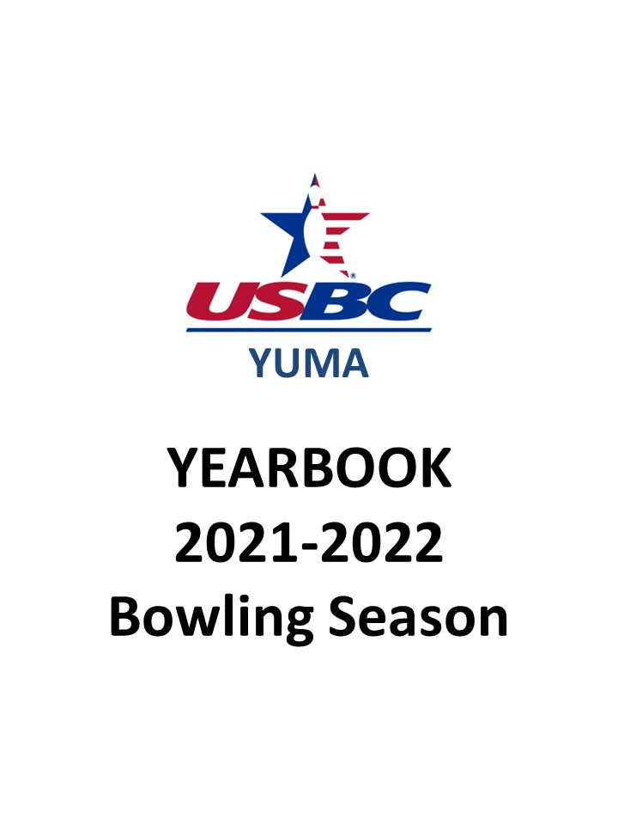
Average “Blue Book”
Available on
www.yumausbc.org
Bowl.com
  Find a member
  (login required as of 1 Aug, 2016)
USBC App
Download and login
2025-2026

Slide 20

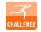
Find a Member “Lane Condition”
Lane Condition Key
Sport League – Sport League - Leagues reporting Sport lane patterns. Averages established in a league are generally 20 pins or lower than those bowled on a standard/ house condition. Please adjust the average using the Sport Bowling Average Adjustment Chart on BOWL.com when average is used for tournaments or leagues conducted on standard or "house" conditions.
Challenge League – Challenge League - This icon indicates this average was bowled on a Challenge Bowling pattern, Lane condition ratio is generally between sport and standard/house. Averages established in a league are generally 10 pins or lower than those bowled on a standard/ house condition.
Standard/House – No icon indicates this average was bowled on a standard or house pattern. Condition applied by center which promotes high scores and averages.

Slide 21
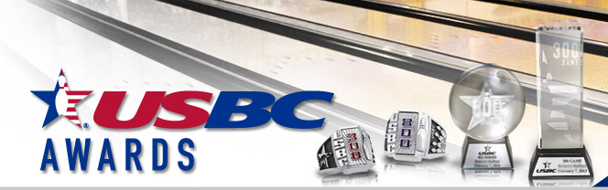
Awards Program
2026 – 2027 Season
  High Score Awards remain Once-in-a-Lifetime
  300, 800, and 900 only honor score awards
Special Achievement Awards
  Provided by the Local Association
    Once per season, regardless the number of leagues bowled in.
    Standard Memberships Only

Slide 22
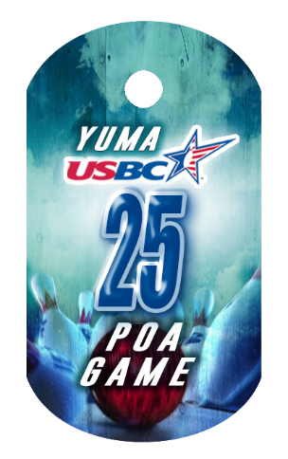

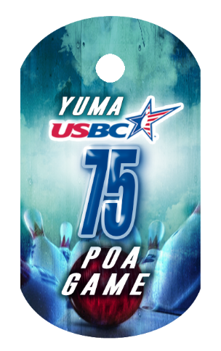






Yuma USBC Awards Program
Replaced the watch
ID Tags
  Performance based (pins over average)
  +25, +50, +75, +100 POA Game +75, +150 POA Series
ID Tags
  All Spare, Dutch 200, Clean Game, 30 Clean
  7-10 split conversion, Big 4 split conversion
  Triplicate Award, and 11 in-a-row Awards

Slide 23
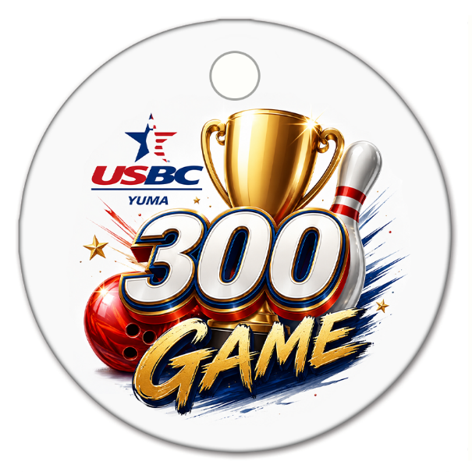


Yuma USBC Awards Program
NEW Award Tags
  100 POA Game Tag – Replaced the USBC Watch
  300 Game
  700 Series (Youth and Women Only)
  800 Series
  Once per season, regardless the number of times bowled, or the number of leagues bowled in.

Slide 24
Yuma USBC Awards Program
Bowler of the Year
  8 Categories
  Youth Boy & Girl Age 17 and under as of Aug 1st
  Adult Male & Female (Ages 18 – 49)
  Senior Male & Female (Ages 50 - 69)
  Super Senior Male & Female (ages 70 & Over)
Association High Average
  Same 8 categories
Association Most Improved Bowler
  Same 8 categories
  Uses previous years book average to compute
  New bowlers w/no book average (use 12 games)

Slide 25
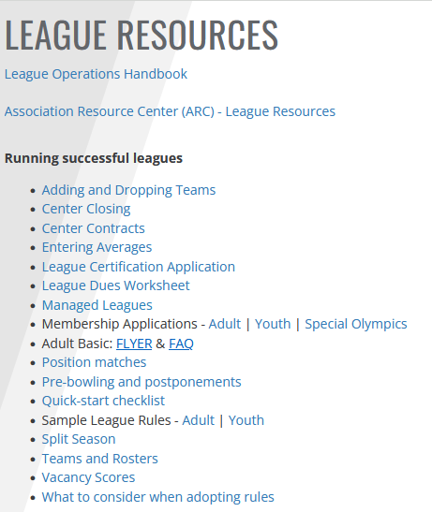
USBC League Operations Handbook
Excellent resource to run a
successful league
Available on Bowl.com
  League Resources
  Handbook PDF format at
  yumausbc.org/forms
Includes
  Duties & Responsibilities
  Sample Accounting Forms
  Verification Worksheet
  Suggested League Rules
Bowl.com has more resources available

Slide 26
The Musts of League Funds
“MUST” is a key word
League Account
  FDIC Approved Institutions or Equivalent
    Bank or Credit Union
  Must be in the Name of the League, not an individual
  Two Officers must sign for any withdrawals
  EIN used to open the account
    EINs provided by IRS (online is easy and fast)
    Secretary Tools has a how to guide if needed
    Transferable, not specific to 1 person

Slide 27
The Musts of League Funds
Deposits
  Made within 7 days of receipt
    Includes fees collected from membership dues
    Failure negates full bonding insurance coverage
Verification
  Statement sent to the League President
  President verifies account monthly
    verification form available to assist
Withdrawals
  Must have 2 signatures
  Expenses must be approved by the Board or in Rules
    Other than weekly lineage

Slide 28
The Musts of League Funds
Withdrawals cont.
  Bonding program covers up to $10,000
  Prize funds greater than $10,000
    USBC recommends payment by checks or money order
  Must distribute prize funds within 7 days after withdrawal
Audit
  President appoints audit committee
  At least 1 audit within the last 30 days
    Audit committee procedures at Bowl.com
Financial Statements
  Provided to each team captain
  Discloses all monies collected and expenditures
  Detail of prizes paid to each team & individuals

Slide 29
Certification
When certifying your league be sure to send the following to the Association Manager within 30 Days of the start of your league:
    Completed League Application – Original Only
    Completed Membership Cards
    Membership fees for all bowlers purchasing
    memberships in your league

Slide 30
Secretary Duties
ALL bowlers must complete a Membership Card in every league they bowl in! This Includes:
  Late Comers
  Subs
  Lifetime Members
Submit additional cards along with any fees due (if applicable)

Slide 31
End-of-Season Duties
Be sure you have submitted Membership
Cards and fees for ALL bowlers
Prepare your Financial Statement for the
league members
Conduct end of season League Meeting
- Elect Officers for Next Season
Distribute Prizefund for the League

Slide 32
League Officer Training
Video Training for the
LEAGUE OFFICERS
Do you know the ins and outs of your current position as a league secretary, treasurer or president? Do you sometimes feel you could be doing a better job with your league duties?
League Secretary
League Treasurer
League President
League Officer Elections
All these training videos can be seen on bowl.com at the following website address.
These training videos are free of charge
https://www.bowl.com/Associations/Association_Home/ARC-LeagueResources/

Slide 33

Yuma USBC Community Events
September is Suicide Prevention Month
  Suicide Prevention Tournament (Sep 26th)
October is Breast Cancer Awareness Month
  SGK Tournament (Oct 10th)
BVL Soldier Pins during November 1st – 8th
  Pins posted on bulletin board
November Food Drive 15th -21st
  Turkey-shoot Tournament (Nov 21st)
Toys 4 Tots Collection Nov 29th – Dec 5th
  Toys for Tots Tournament (Dec 5th)

Slide 34
Community Events (Cont)
Christmas Family Donation/Collection
Relay for Life Event
  Fundraiser Tournament 9 Jan
  Relay for Life Event (March 20th)
March of Dimes (collecting dimes all month)
  March of Dimes Tournament (Mar 27th)
Autism Awareness in April
  Tournament April 24th
Back 2 School Tournament (Youth Event)
  Backpacks & School supplies donated

Slide 35
Leagues Can Help Too
Adopt-a-Youth Program
  Pledge amount of league fees each week
  Payable at the end of the season
Scholarship Donations
  Helen Karlovich Scholarship
BVL Bowlers to Veterans Link
  Donate amount of league fees each week
  Conduct 50/50 raffles to raise money
Bowl for the Cure / Susan G. Komen
  Donations of league fees or 50/50 collection

Slide 36
Inca Lanes
Paperwork for your League
Team Sign-up Sheets
Standing Sheets
  Uploaded to LeagueSecretary.com
  For Convenience NOT Official
Recap Sheets
End of Year Bowler Record

Slide 37

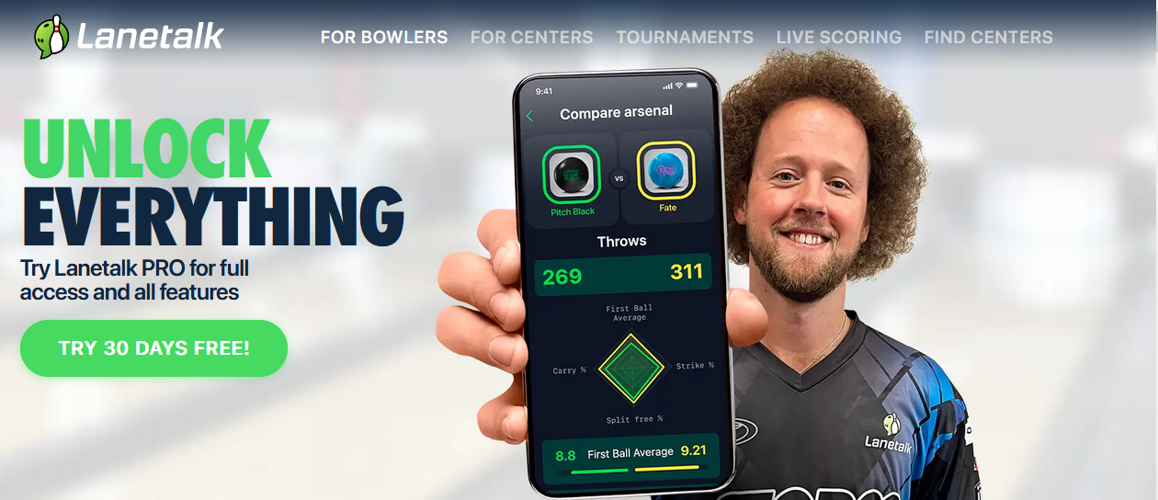

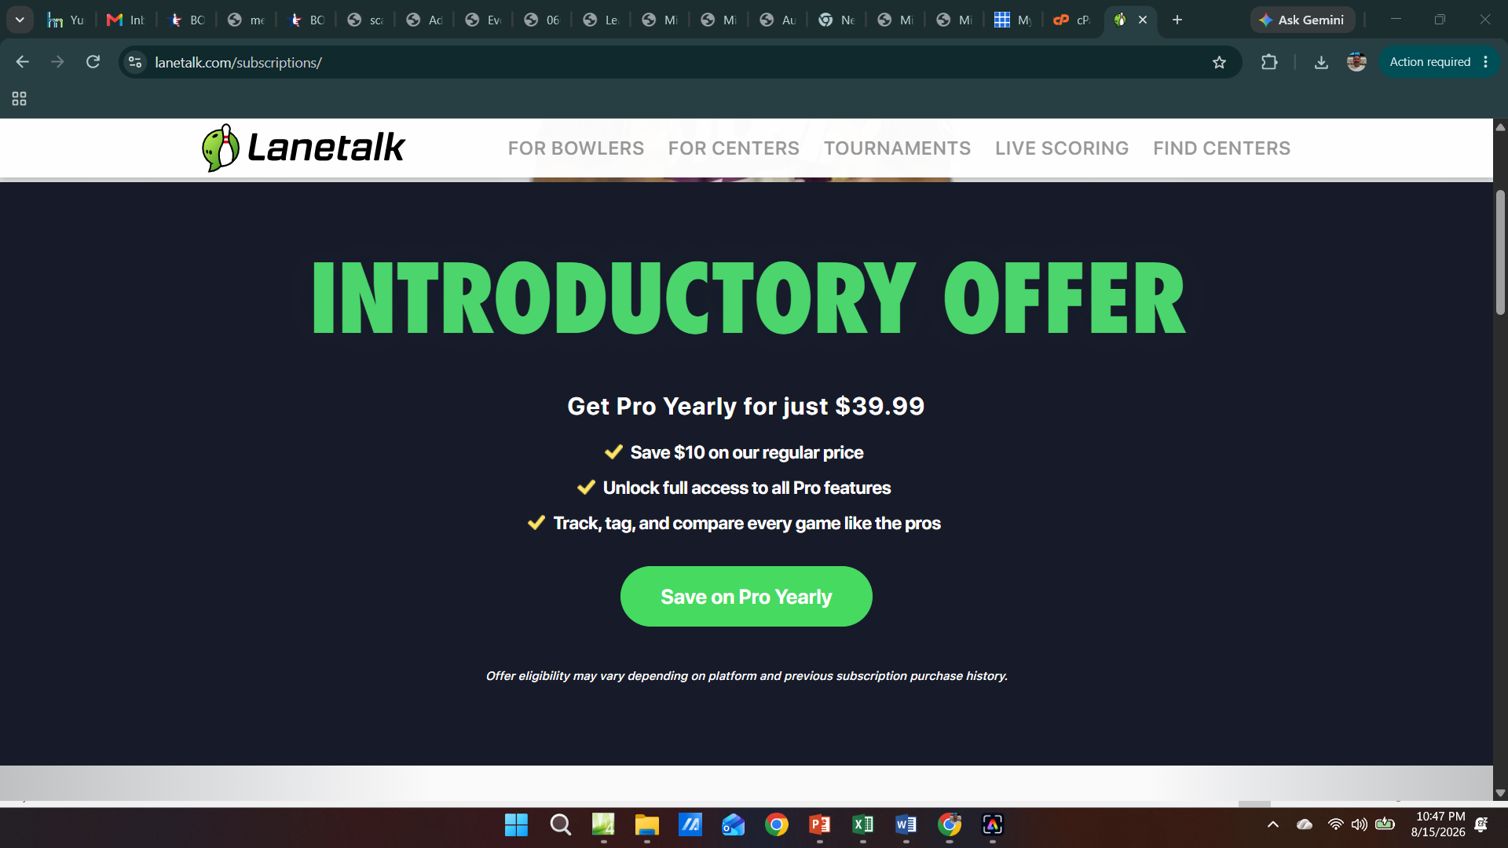
Inca Lanes

Slide 38
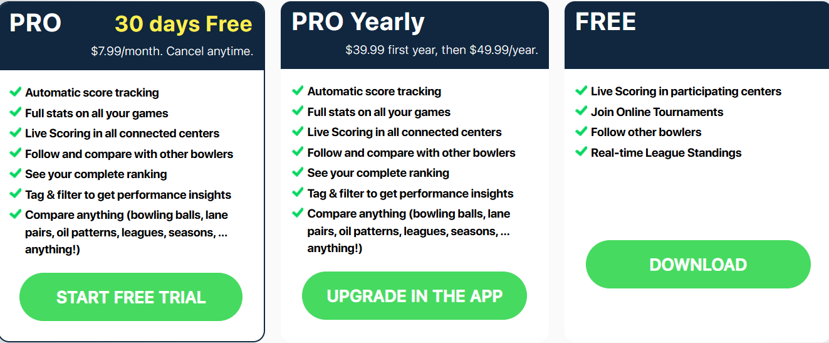
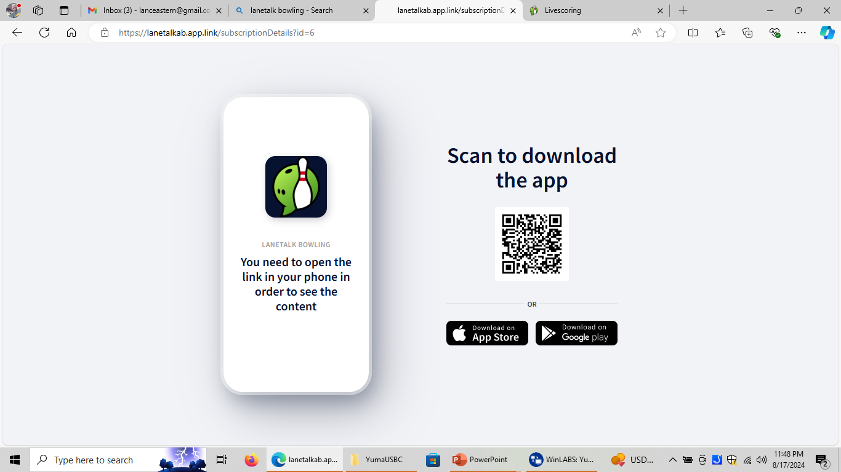
Inca Lanes

Slide 39
Visit Us On the Web
www.yumausbc.org
  lots of information posted
Like US on Facebook
  www.facebook.com/yumausbc

Slide 40
Wrap Up / Q & A Session
Are You Ready to Have a Successful Season?
We’re Here to Help!

